Slide 1

CSE4227 Digital Image Processing
Chapter 11 Representation and Description
_{( Chain Code)}
Dr. Kazi A Kalpoma
Professor, Department of CSE
& Director of ICT
Ahsanullah University of Science & Technology (AUST)
Contact: kalpoma@aust.com
Google Class code: cgxyzjp
CSE | AUST
Fall 2020

Slide 2
Today’s Contents
  What is Image representation?
  What information we can use to represent an image?
  Boundary Based Image representation
  Chain Code
    Types
    Properties
    Problems in Chain Code Representation
    Solutions
    Advantages & Disadvantages
    Examples of Shape Number
Chapter 11 from R.C. Gonzalez and R.E. Woods, Digital Image Processing (3rd Edition), Prentice Hall, 2008 [ Section 11.1.1, 11.1.2 ]
Notes:
kalpoma@gmail.com

Slide 3
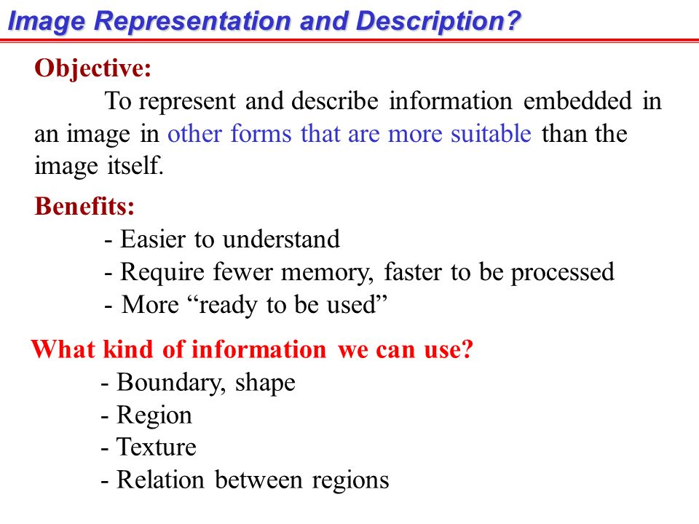

Slide 4
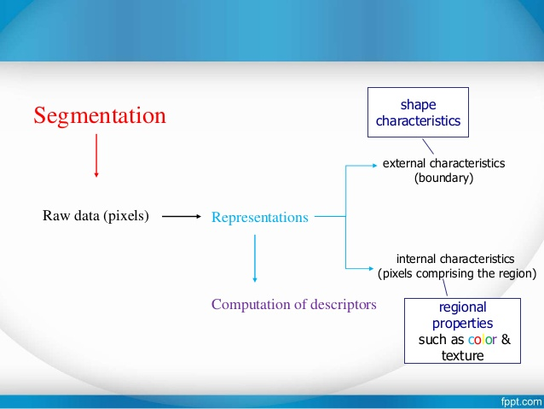
Image Processing

Slide 5
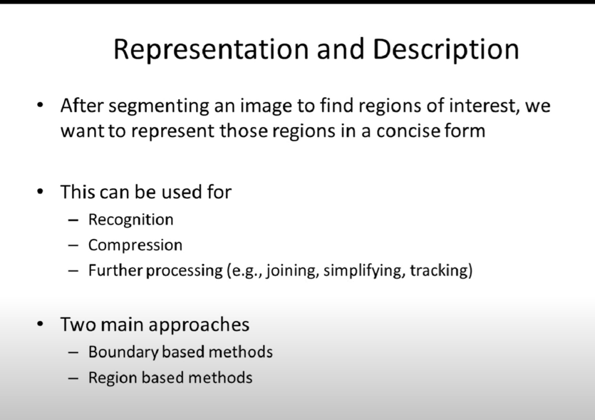

Slide 6
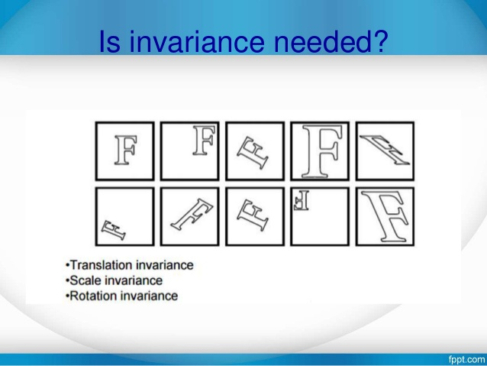

Slide 7
Boundary based
Image Representation

Slide 8
Chain Code
Freeman Chain codes are actually one of the oldest techniques in computer vision originally introduced.
The basic principle of chain codes is to separately encode each connected component, or "blob", in the image.
Notes:
*

Slide 9
Introduction
A technique to represent the region or object by describing its contour.
Works on connected component
A chain code is a boundary representation technique by which
“A contour is represented as a sequence of straight line segments of specified length (usually 1) and direction”.
*
Notes:
*

Slide 10
Types of Chain Code
8-neighbor : It works with 8-neighbor of a contour pixel. It will follow the contour and keep generating direction number that is generated in anti-clockwise manner.
4-neighbor: This representation also known as crack code. Works with 4-neighbor of pixel which can define the boundary line.
*
Notes:
*

Slide 11
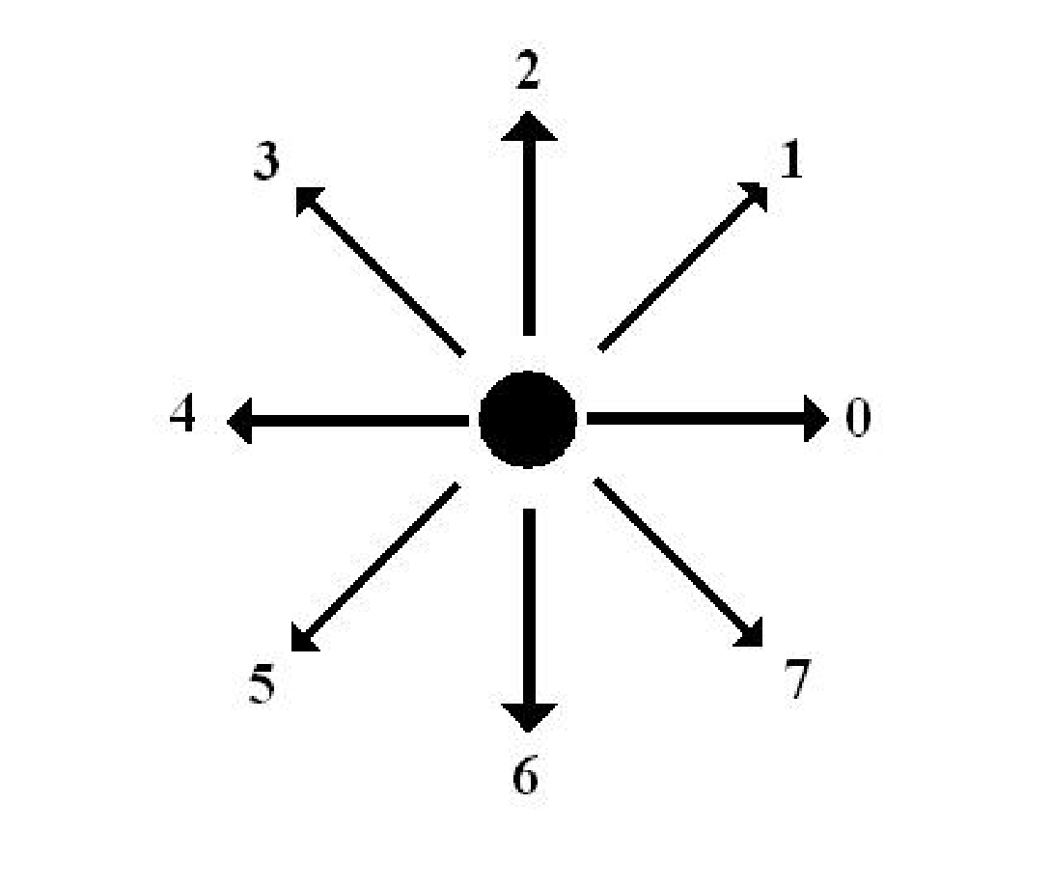
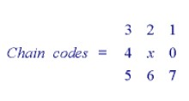
Continue.....
The codes associated with eight possible directions are the chain codes
With x as the current contour pixel position, the codes are
generally defined as:
*
Notes:
*

Slide 12
Properties of 8-neighbor Chain Code
Even codes {0,2,4,6} correspond to horizontal and vertical directions; odd codes {1,3,5,7} correspond to the diagonal directions.
Each code can be considered as the angular direction, in multiples of 45deg., that we must move to go from one contour pixel to the next.
*
Notes:
04/02/2019
compter vision
*

Slide 13
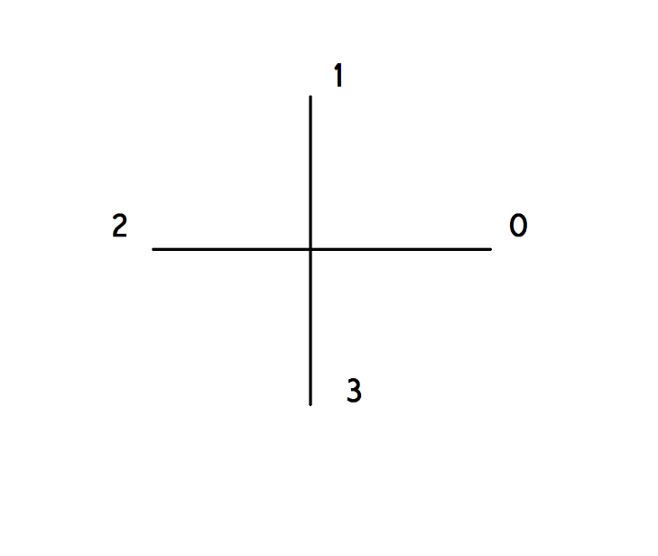

4-neighbor Chain code
The "crack" code can be viewed as a chain code with four possible directions instead of eight.
*
Notes:
*

Slide 14
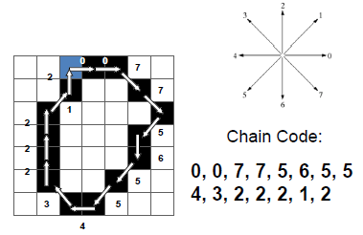
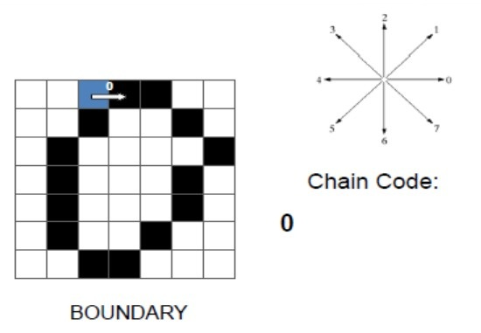
Steps of chain codes
  Select some starting point of the boundary and represent it by its absolute coordinates in the image
  Represent every consecutive point by a chain code showing transition needed to go from current point to next point on the boundary
  Stop if the next point is the initial point or the end of the boundary
*

Slide 15

Simulation
4
4
= Starting
6
2
3
5
6
2
7
1
0
0
*
Notes:
*

Slide 16
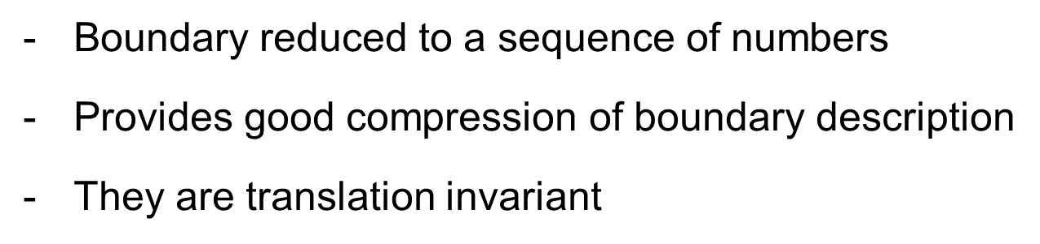
Advantages
*
Notes:
*

Slide 17
1) Change Starting Point
CC: 03032211
CC: 03221103

Slide 18
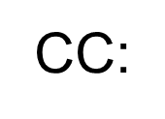
3) Reflex
01033221

Slide 19
3) Rotation
CC: 10033212

Slide 20
Chain Code changes in
  Changing start point
  Reflex
  Rotation
Solution is Normalization
3 steps:
  Calculate chain code
  Calculate circular first difference (CFD)
  Calculate Normalize CFD (aka Shape Number)

Slide 21
1) Change Starting Point
CC: 03032211
CFD: 31330303
NCFD: 03033133
CC: 03221103
CFD: 33030331
NCFD: 03033133

Slide 22
2) Reflex
CC: 01033221
CFD: 13303033
NCFD: 03033133

Slide 23
3) Rotation
CC: 10033212
CFD: 30303313
NCFD: 03033133

Slide 24
Chain Code Independent of Location, Starting Point and Orientation
Chain Code:
444201066
066444201
067644222
Curvature = differences in chain code values :
0022-11-602
-6020022-11
-6-11202002
Normalize curvature = mod 8 :
002271202
202002271
271202002
Code is the cyclic permutation which produces the smallest number:
002271202

Slide 25
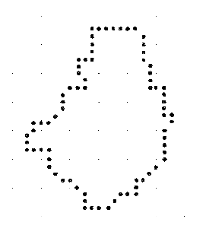
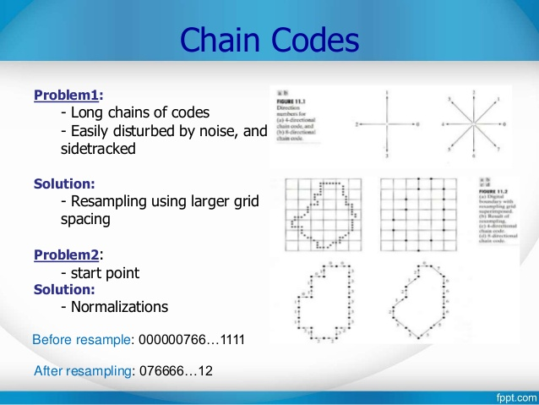
Another Example:

Slide 27
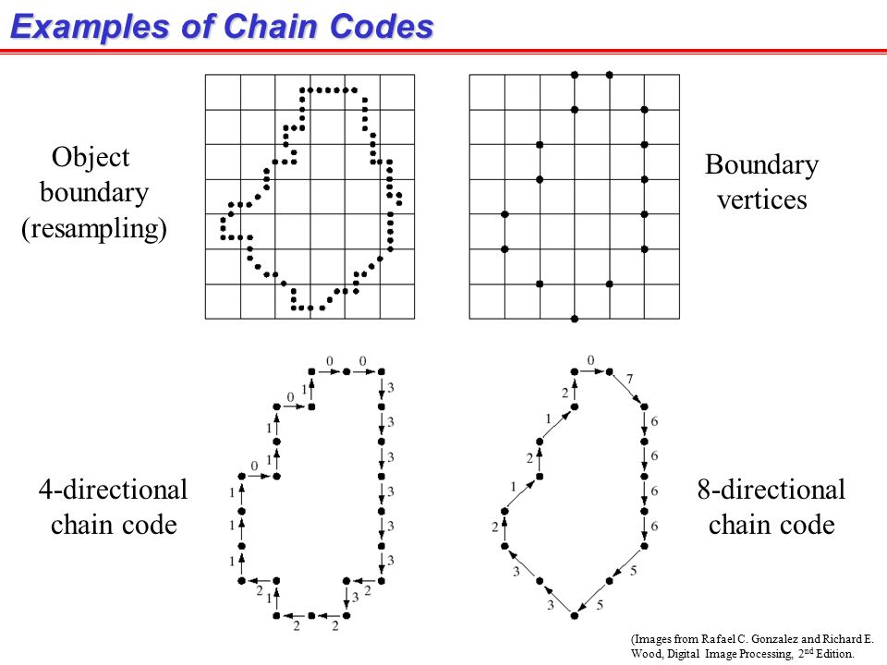

Slide 29
Disadvantages
Long chains of codes
No invariance to Rotation and Scale
Sensitive to Noise
Solution:
Re-sample the image to a lower resolution before calculating the code
*

Slide 30
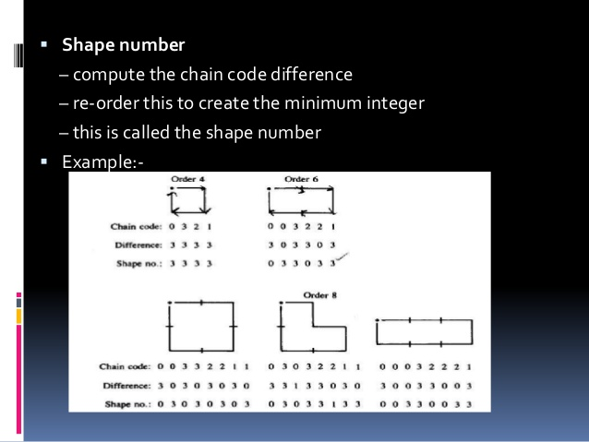

Slide 31
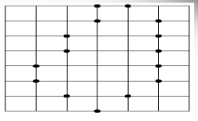
Class Work
An image is given as in the figure below. Write down the 8-chain code and find the shape number of it.
Starting point
*

Slide 32
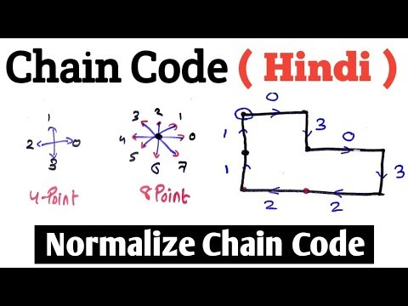
https://youtu.be/NPyBHVmlyDY
Image Processing and Computer Vision: 5

Slide 33
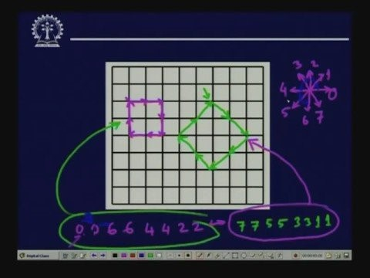
https://youtu.be/Dd3xWUi7JlY
Image Processing and Computer Vision: 5

